Slide 1
Chapter 8, Method B
Niches of Birds at a Feeding Station

Slide 2
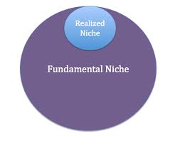
Fundamental niche- the role that an organism could theoretically occupy if there was no competition in the population.
Realized niche- the altered niche, or role, that the organism actually occupies due to the presence of competition.
Fundamental vs. Realized Niche:

Slide 3
Lab Study vs. Field Study
Participants in a lab study may have an altered behavior due to unnatural envrionment.
Participants in a field study are watched in their natural habitat under natural conditions.

Slide 4
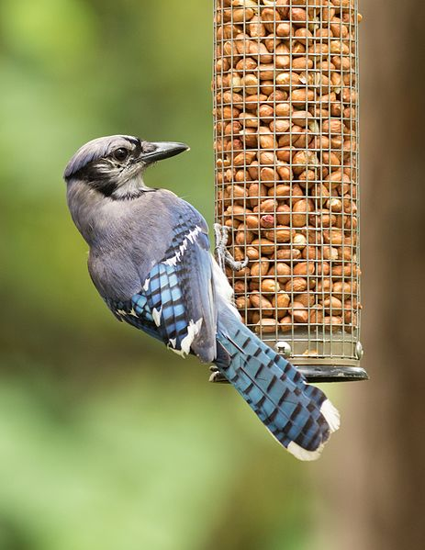
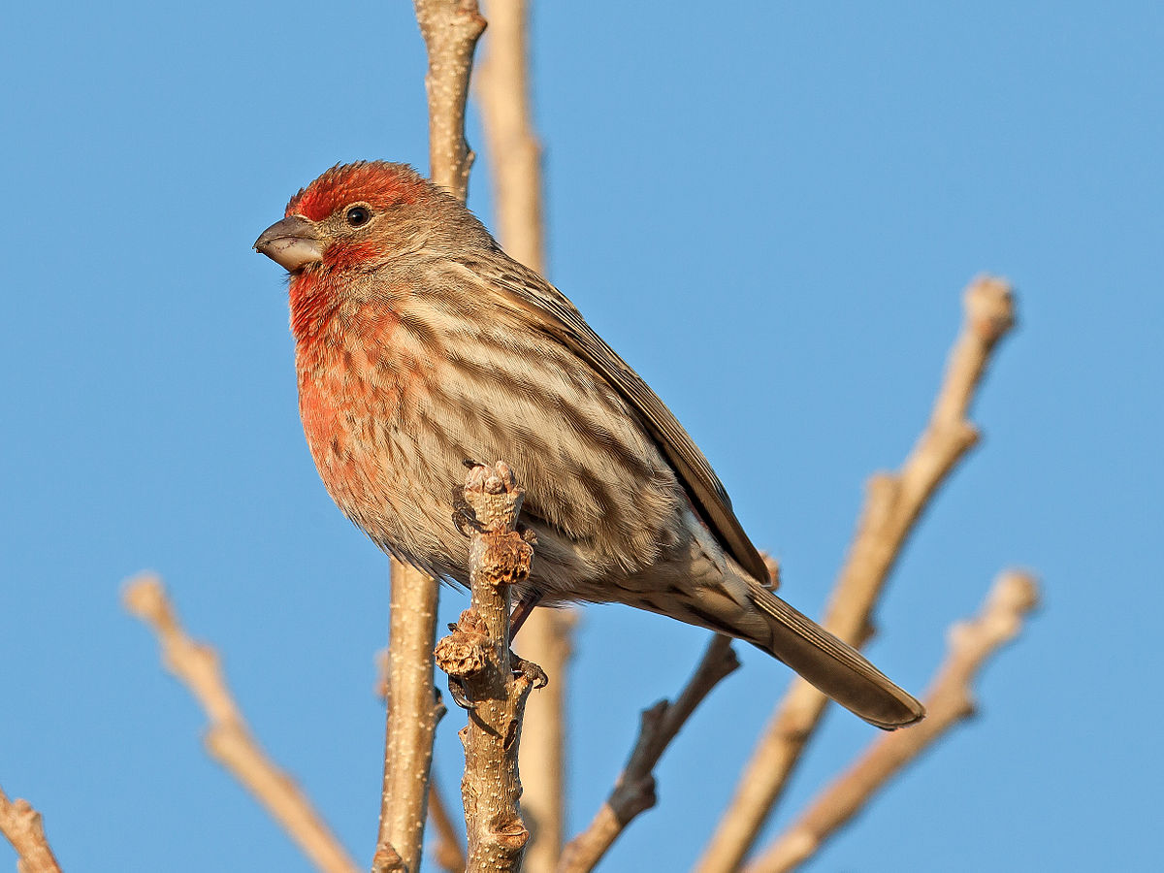
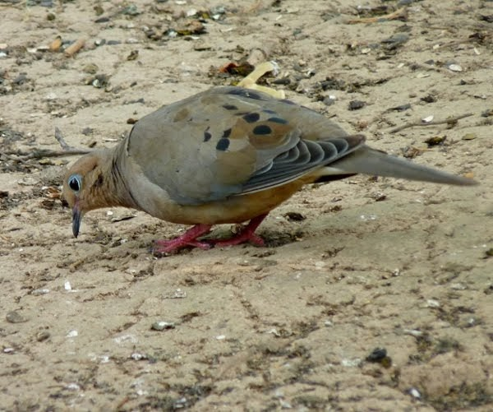
Feeding Station Niches
Bird lands on feeder and stays on feeder to eat | Bird takes seed from the feeder and eats at a different location | Bird eats seed on the ground, under the feeder
This Photo by Unknown author is licensed under CC BY-SA.
This Photo by Unknown author is licensed under CC BY-SA.
This Photo by Unknown author is licensed under CC BY-SA.

Slide 5
Null Hypothesis
Every species of bird will use the feeder in the same way.

Slide 6
Chi-Square Contingency Table (p. 193)
Only using the top 5 most observed species
Record the number of times each species was observed occupying each niche
Calculate the expected number:
                Expected Number = ( Species Total ) x ( Niche Total)
Grand Total

Slide 7
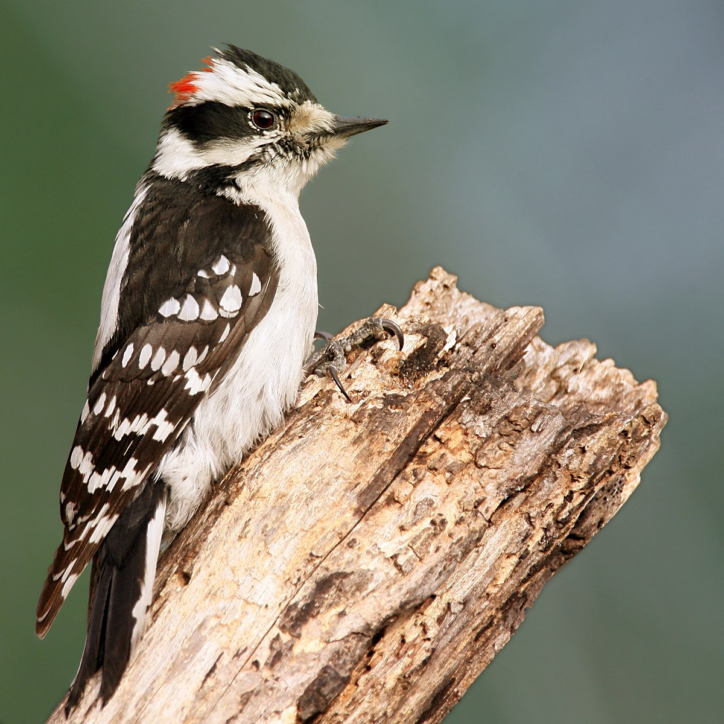
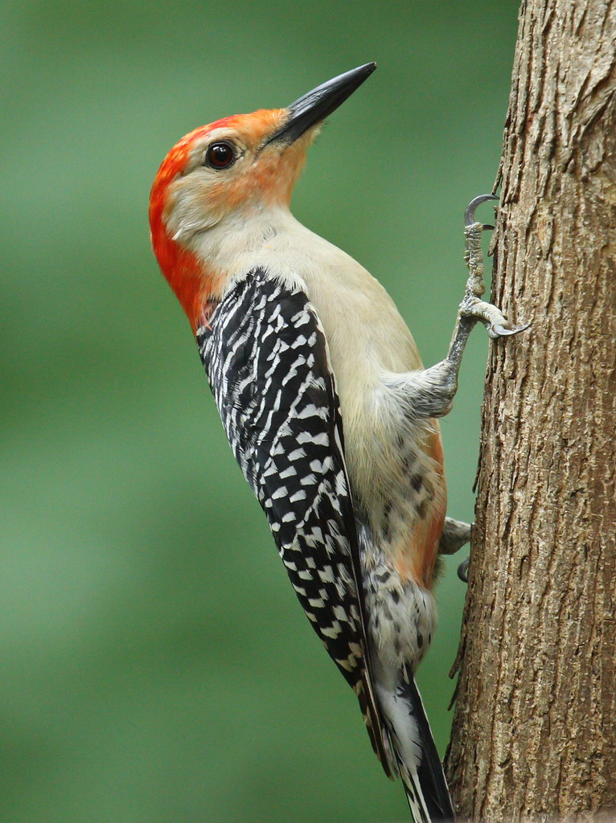
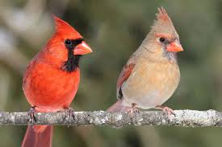
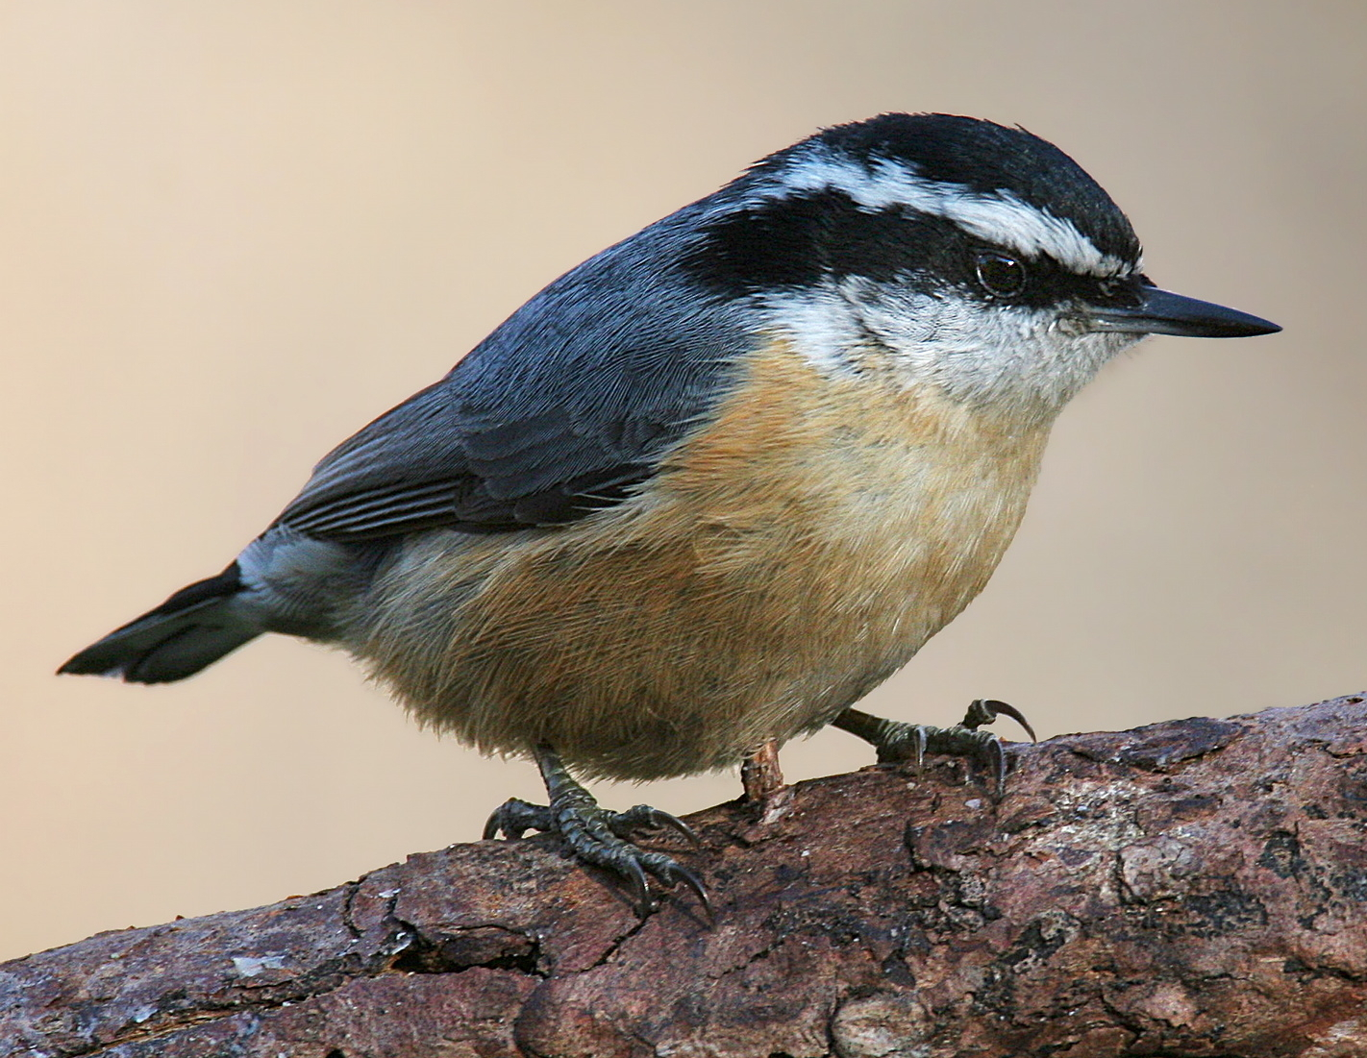
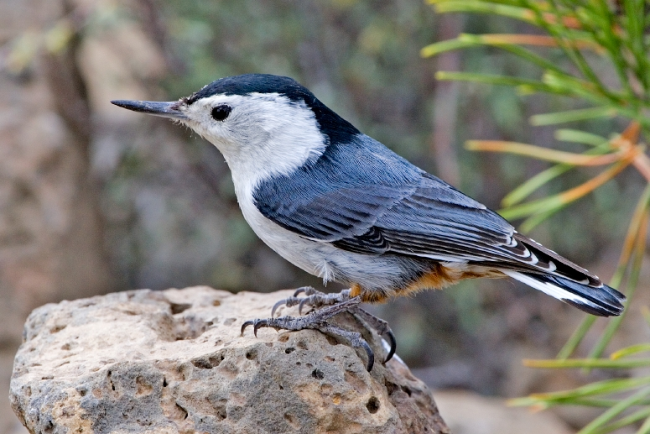
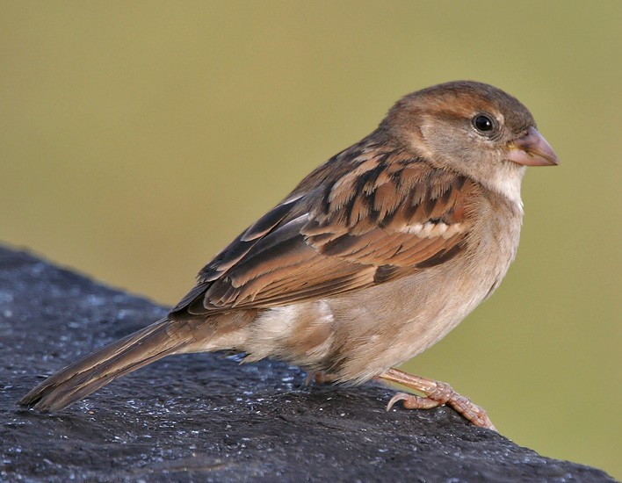
Downy Woodpecker
Northern Cardinal
Male
Female
Red-bellied Woodpecker
White-breasted nuthatch
House Sparrow
Red-breasted nuthatch

Slide 8
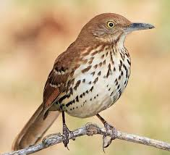
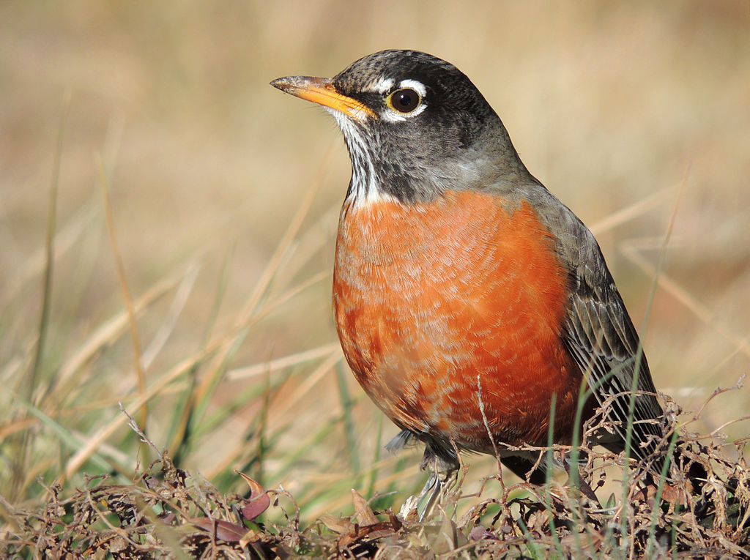
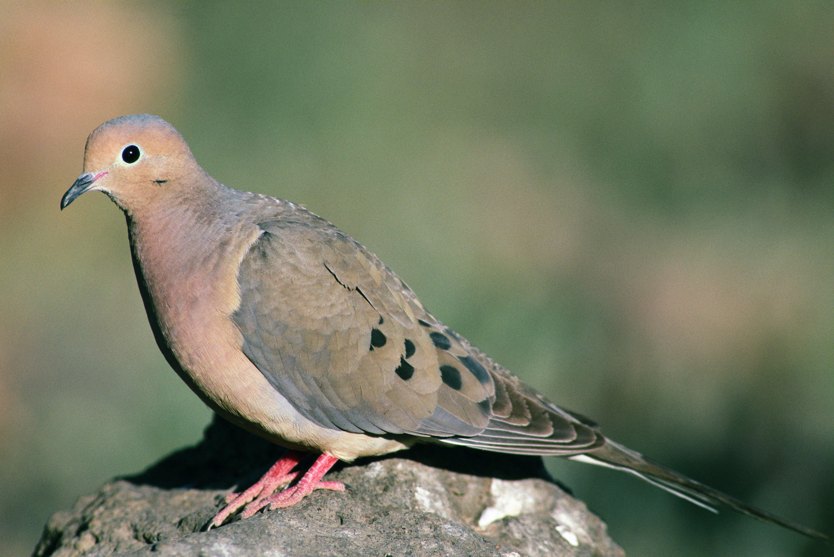
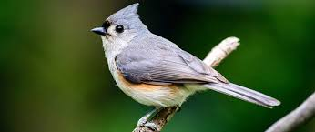
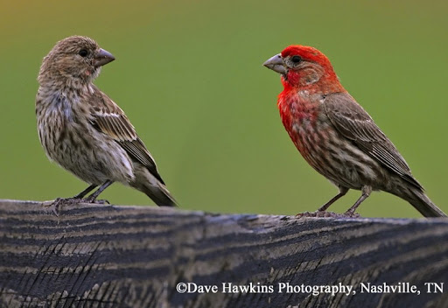
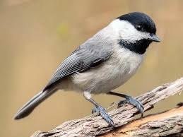
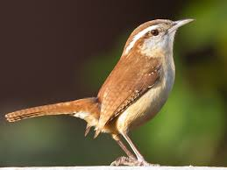
House Finch
American Robin
Brown Thrasher
Mourning Dove
House Finch
Tufted Titmouse
Carolina Chickadee
Female
Male
Carolina Wren

Slide 9
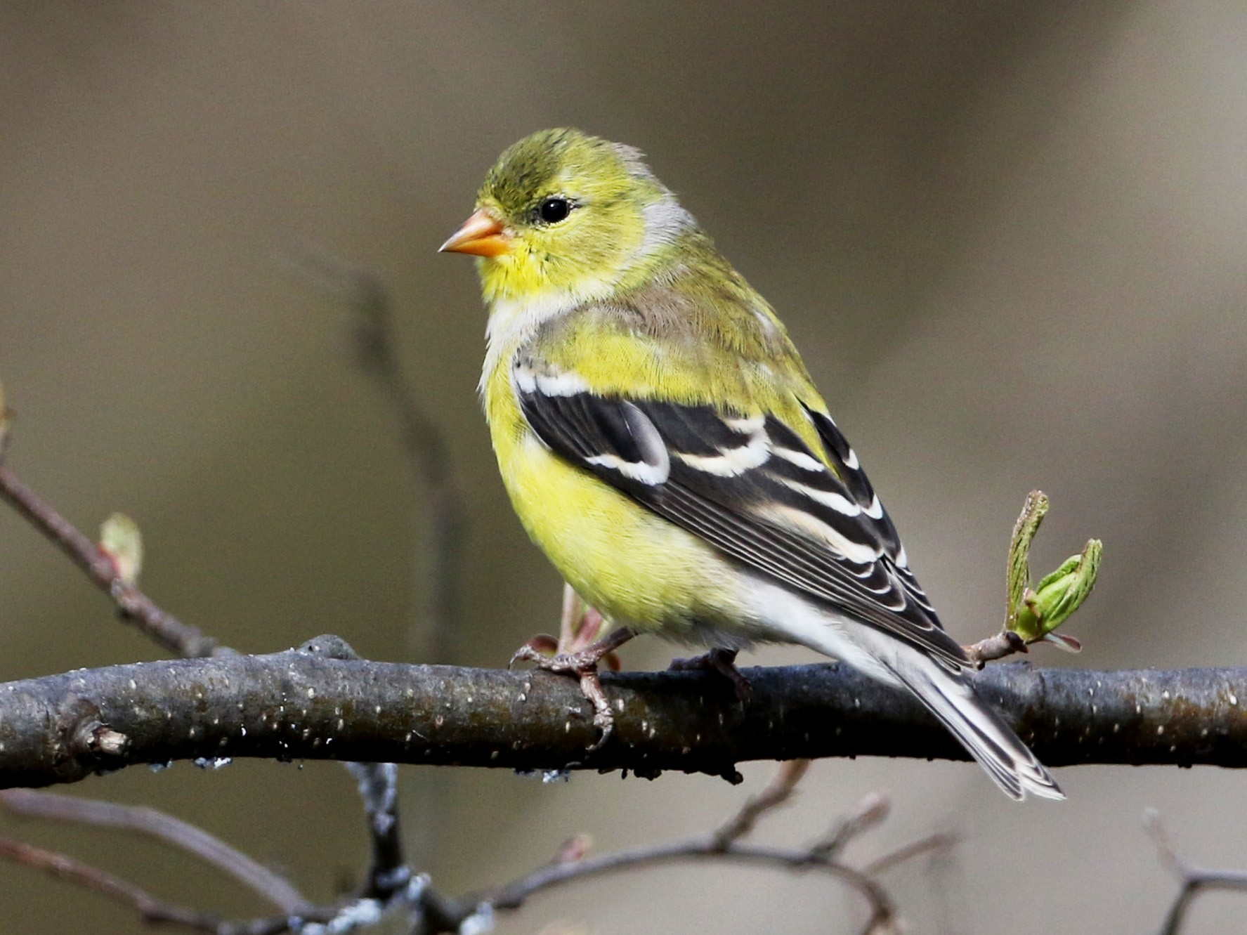
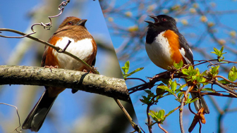
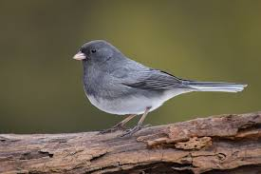
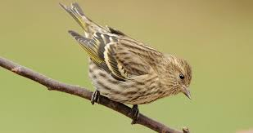
Eastern Towhee
American Goldfinch
Male
Female
Dark-eyed Junco
Pine Siskin

